Slide 1
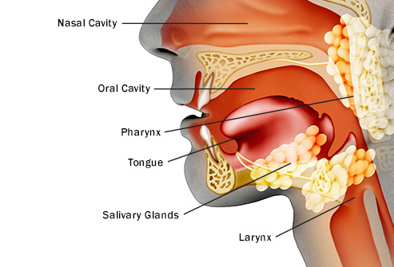
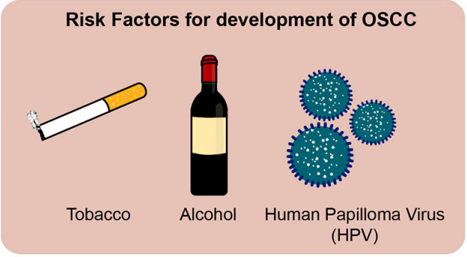
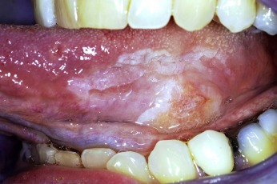
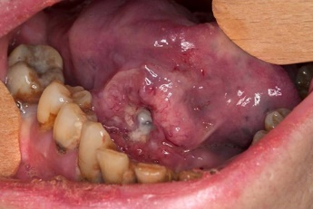

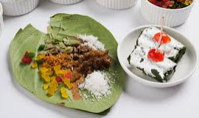
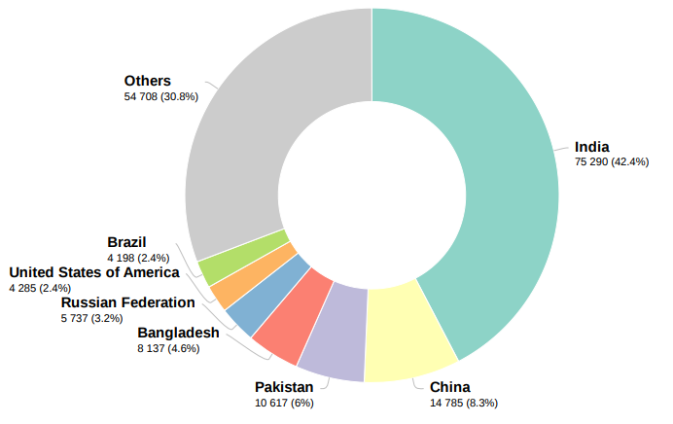
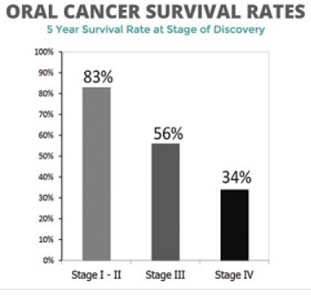
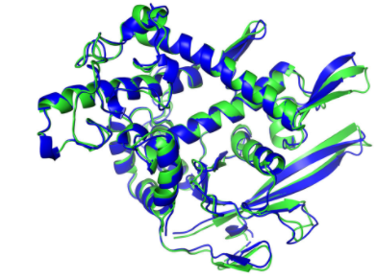

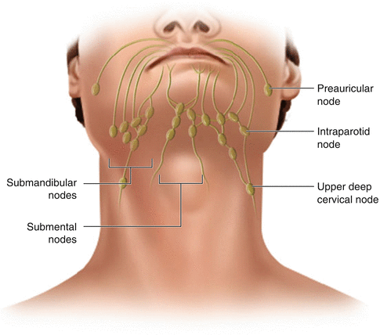




Oral cancer Research: Multi-OMICs Approach
1. Anatomy
2. Causative agent
Mechanism?
Surface Epithelium
Molecular Alteration
Exposure
Squamous cell carcinoma (SCC)
Most common type (90-95 %)
Pre-Malignant Lesions
Metastatic Tumor
3. Global Scenario
India 75,290(42.4%)
Workflow Overview
Oral Cancer Samples (Tumor, Saliva and Serum)
Total Deaths 177,757
Data Analysis and Interpretation
Biomarker discovery
Pathway Analysis
Novel Network Identification
Potential Therapeutic Target Identification
Validation of Potential Biomarker
Prediction of Health and disease
Protein
Proteomics
6th most common malignancy in the world
Major health problem in India; Ranks among top Three most common cancer
DNA/RNA
4. Diagnosis & Treatment
Why mortality rate is high?
Genomics and Transcriptomics
Metabolite
Metabolomics
60% Late diagnosis
Therapies are ineffective in advanced stages
Network of Lymph Node

Slide 2
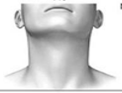

Oral Cancer: Biology and Work Plan
Pre-Malignant Lesions
Metastatic Tumors
Mechanism?
Exposure of causative agent
Mechanism?
Advanced-stage cancer
(Lymph Node Metastasis)
Early-stage cancer
(No lymph Node Metastasis)
Molecular Alteration
Biomarkers?
Sub-Mucosa Fibrosis, Leukoplakia, Erythroplakia
N0
N1, 2, 3
Notes:
1. Oral Cancer is the malignancy of “oral cavity, throat and larynx” and OSCC( Oral Squamous cell carcinoma) is the most common type of oral cancer originated from the surface epithelium.
2. Oral cancer has a multifactorial cause include alcohol use, tobacco exposure, continued stimulation (Betel quid chewing), and virus infection such as Human Papilloma Virus(HPV) and In India, tobacco exposure is the major cause of the oc.
3. In 2020, about 177,757 are died and 42.4% of patients died from India only

Slide 3
1.Identification of potential classifiers involved in nodal metastasis of oral squamous cell carcinoma (OSCC) by using machine learning approach. (Sathwik 22b2209)
2. A comprehensive proteomics and metabolomics analysis utilizing machine learning algorithms to identify robust molecular classifiers for the early detection of oral squamous cell carcinoma. (Soumitra-22b0984)

Slide 4





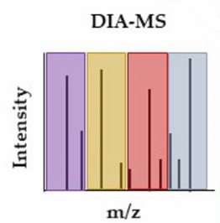
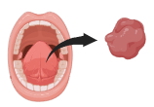



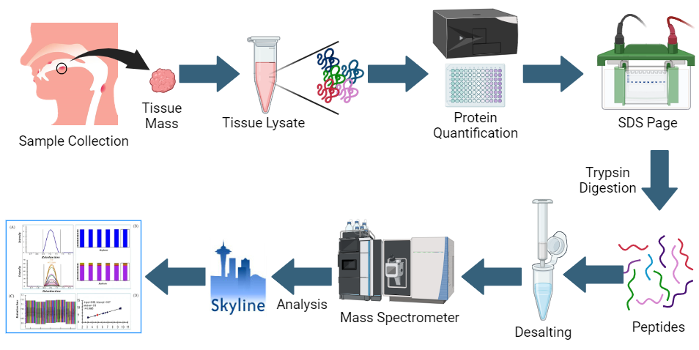
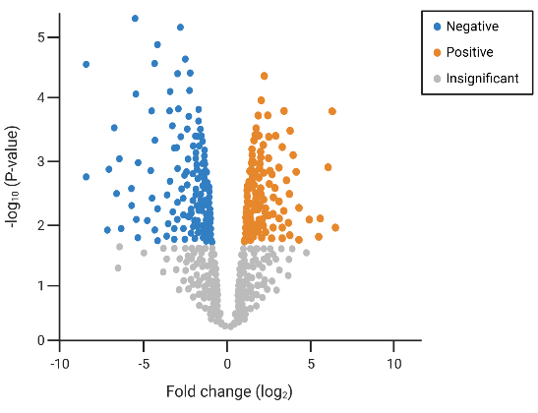
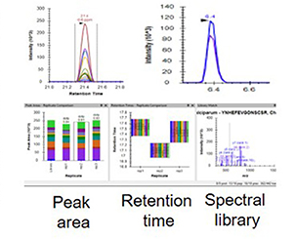

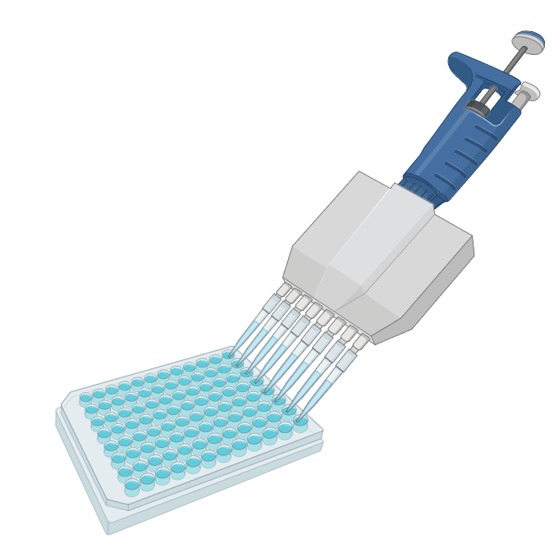
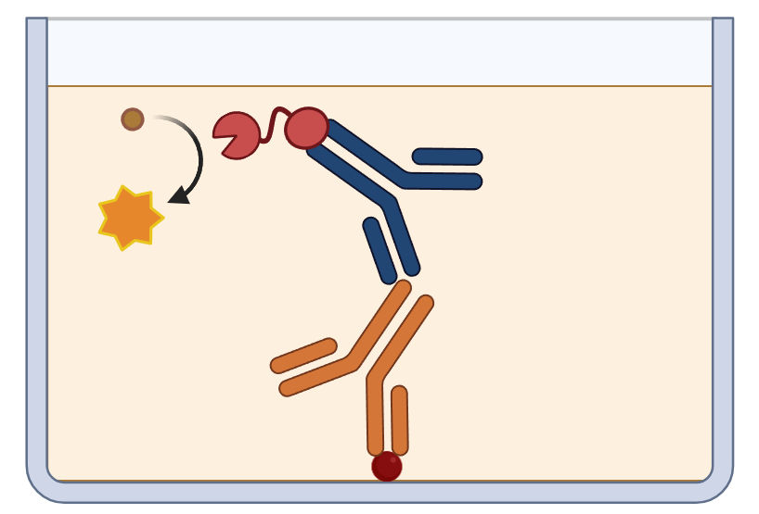
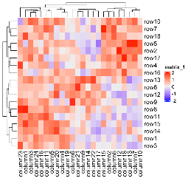

Objective 1: Schematic Workflow for Proteomics Analysis
Sample collection
Sample Processing
Serum
Tissue
Protein extraction and digestion
Desalting
LC- MS/MS
84 Samples (42 Paired Tissue, Saliva and Serum samples),
35 Healthy Volunteer for Saliva & Serum
Saliva
Identification of secretory DEPs
Data analysis and Interpretation
Validation of secretory proteins
Targeted Proteomics
Data analysis
Data normalisation and statistical analysis
ELISA
Data interpretation and visualisation

